Slide 1
Designing Movies Recommendation webpage using Flask Framework and Machine Learning
T. SAI RAVI TEJA – 19BCE7150
V. SAI MANIKANTA – 19BCE7762
M. SAI PRANETH – 19BCE7094

Slide 2
INDEX

Slide 3
INTRODUCTION……………………………………………………………………………….4
MOTIVATION…………………………………………………………………………………….6
OBJECTIVE……………………………………………………………………………….………8
LITERATURE SURVEY………………………………………………………………………10
PROJECT SCOPE……………………………………………………………………….……17
GENERAL TASK INVOLVED………………………………………………………………19
REQUIREMENTS……………………………………………………………………………….21
ARCHITECTURE DIAGRAM……………………………………………………………….24
HYPOTHESIS…………………………………………………………………………………….26
UML DIAGRAMS…………………………………………………………………………………28
FRONT END……………………………………………………………………………………….33
MACHINE LEARNING MODEL…………………………………………………………….36
RESULTS…………………………………………………………………………………………….41
CONCLUSION……………………………………………………………………………………..45
FUTURE SCOPE………………………………………………………………………………….47
REFERENCES……………………………………………………………………………………….49
TIME LINE……………………………………………………………………………………………51

Slide 4
INTRODUCTION

Slide 5
Movies has been part of everyone life now a days getting favorite movies has been a task. Movies similar to their liked movies might be their favorite ones.
This approach is useful now a days as there are lots of movies out there to watch and often confuse what to watch.

Slide 6
MOTIVATION

Slide 7
Watching movies is everyday routine in many people life. But getting movies based on their interst has been a difficult task.

Slide 8
OBJECTIVE

Slide 9
To create a website which recommends users films based on the user interest using Machine Learning Algorithm.

Slide 10
LITERATURE SURVEY

Slide 11
s.No | Title | Key Points | Author | Year
1 | Movie Recommendation System Using Machine Learning Publisher: IJRIE | KNN based Machine learning algorithm First, a new user is provided with a screen that contains a search bar that allows him to search for a particular movie. The user’s local data, which is the movies he has previously watched and the ratings provided by him will be stored in a separate database. All the information about movies such as genre, abstract, the title will be stored in a “Movie data” Collaborative Model based filtering is used. | F.Furtado A. Singh | 2020

Slide 12
s.No | Title | Key Points | Author | Year
2 | A Review on Movie Recommendation System Using Machine Learning Publisher: IEEE | CONTENT BASED FILTERING COLLABORATIVE FILTERING KNN ALGORITHM MATRIX FACTORIZATION | Smitha Anusha | 2021

Slide 13
s.No | Title | Key Points | Author | Year
3 | Movie Recommendation System using Machine Learning Algorithms Publisher: IRJET | Movie Recommendation website Based on the user movie information Filtering is done Sign –in page and user home page Collaborative Filtering is used for recommending movies | Akansh Surendra Aditya Kumar Yadav | 2020

Slide 14
S.No | Title | Key Points | Author | Year
4 | Rating Prediction on Movie Recommendation System: Collaborative Filtering Algorithm (CFA) vs. Dissymetrical Percentage Collaborative Filtering Algorithm (DSPCFA) Publisher: IEEE | Movie Recommendation using CFA Movie Recommendation using DSPCFA KNN Based Filtering Comparing the results of both CFA and DSPCFA Proving which one is better | Johan Eko Purnomo Sukmawati Nur Endah | 2019

Slide 15
s.No | Title | Key Points | Author | Year
5 | Design of an Unsupervised Machine Learning-Based Movie Recommender System Publisher: MDPI | affinity propagation agglomerative spectral clustering association rule with Apriori algorithm average similarity clustering performance evaluation Dunn Matrix mean squared error mini-batch K-Means recommendations system K-Means social network analysis | Debby Cintia Ganesha Putri Jenq-Shiou Leu | 2020

Slide 16
S.No | Title | Key Points | Author | Year
6 | A Movie Recommender System: MOVREC using Machine Learning Techniques Publisher: IJESE | Content Based Filtering It allows a user to select his choices from a given set of attributes. Using K-means Machine Learning Algorithm. Then recommend him a movie list based on the cumulative weight of different attributes and using K-means algorithm. | Ashrita Kashyap Sunita | 2020

Slide 17
PROJECT SCOPE

Slide 18
Time saving:
Many people have problems selecting their interested movie due to lack of time and due to search issues.
Also movie recommendations from friends can be time consuming. This website helps in saving lots of time.
Interest towards movies:
People like to watch movies. So there will be a lot of users for the website. Which increases the scope of the website.

Slide 19
GENERAL TASK INVOLVED

Slide 20
1.User should select movie name and count which they liked on the webpage.
2.Movie name and count will be passed through API call to Machine Learning model
3.Machine Learning model will recommend the movies
4.That movies information will be displayed on the web page

Slide 21
REQUIREMENTS

Slide 22
Technologies
Front end: HTML,CSS
Back end: PYTHON
Frame Work: FLASK
Editor: VISUAL STUDIO CODE

Slide 23
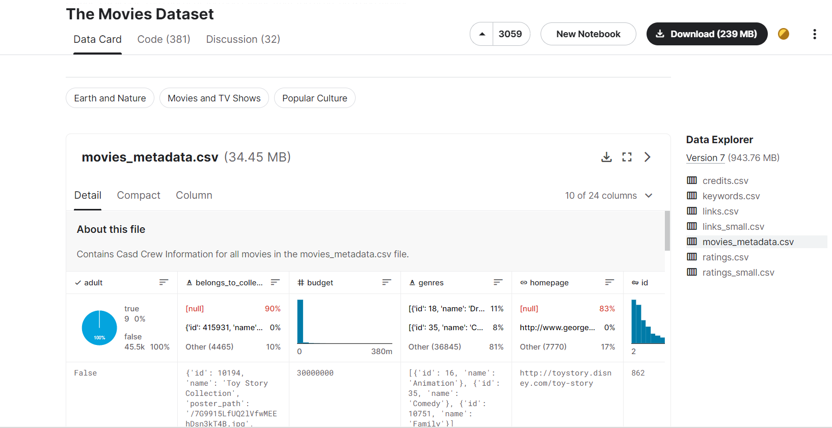
Source of Database used for project
Movies Dataset and Rating is download form Kaggle website they provide free Datasets.

Slide 24
ARCHITECTURE
DIAGRAM

Slide 25
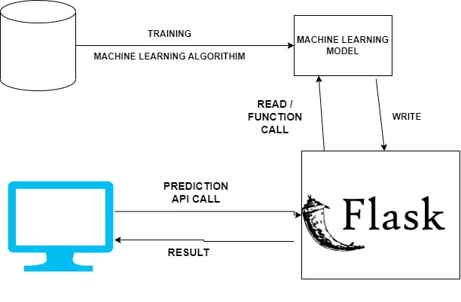

Slide 26
HYPOTHESIS

Slide 27
1. FULL WORKING MOVIE RECOMMENDATION WEBPAGE
2. COLLABORATIVE FILTERING BASED MACHINE LEARNING MODEL
3. EASY TO USE USER INTERFACE

Slide 28
UML DIAGRAMS

Slide 29
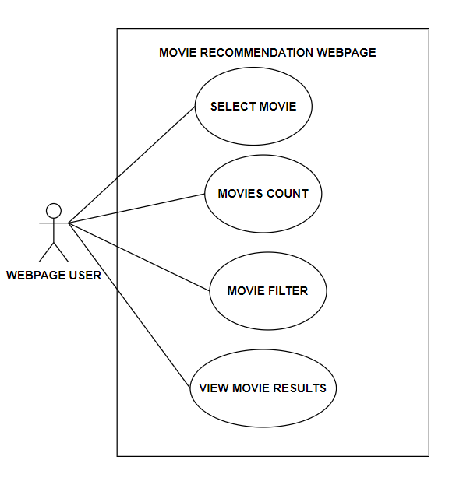
Use Case Diagram

Slide 30
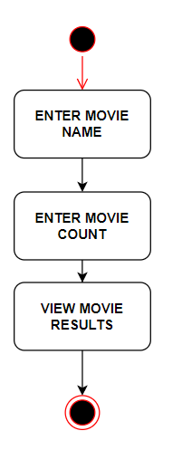
Web Page User Activity Diagram

Slide 31
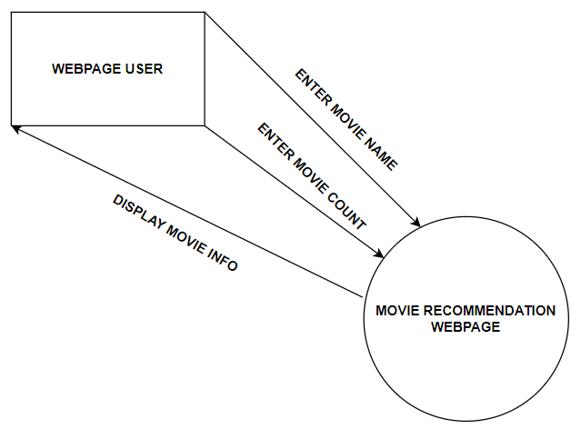
Level-0 Data Flow Diagram

Slide 32
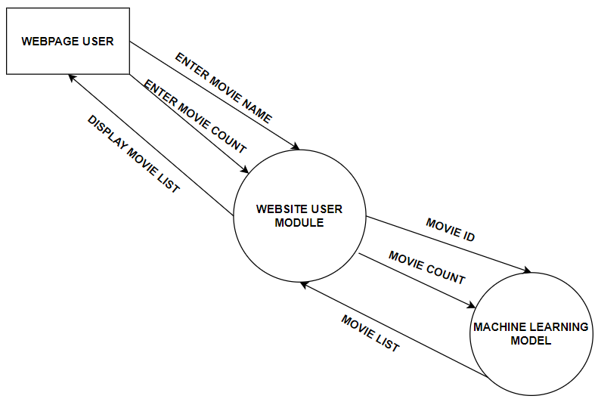
Level-1 Data Flow Diagram

Slide 33
Front End

Slide 34
Tags and Buttons used:-
Dropdown Text Box:-
For Entering the Movie Name
Text Box:-
For Entering the movie Count
BUTTON:-
For Getting movie details

Slide 35
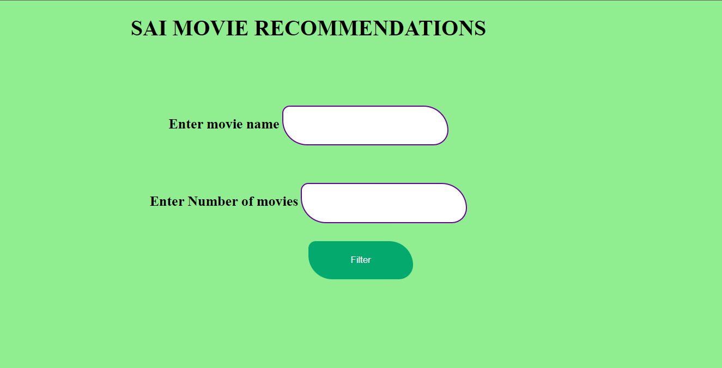
Webpage Frontend

Slide 36
MACHINE LEARNING MODEL

Slide 37
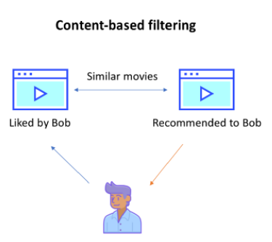
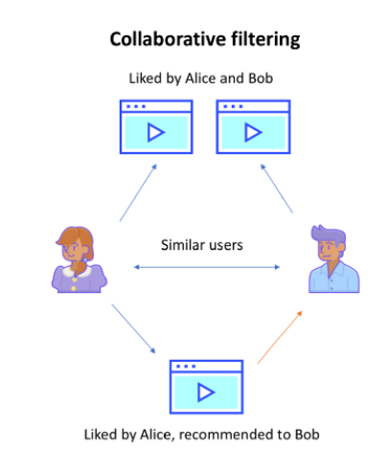
Filtering Methods
There are two types of filtering methods:-
1.Content Based Filtering
The content-based approach uses additional information about users or items. This filtering method uses item features to recommend other items similar to what the user likes.
2.Collaborative Based Filtering
Collaborative filtering method for recommender systems is a method that is solely based on the past interactions that have been recorded between users and items to produce new recommendations. It tends to find what similar users would like and the recommendations will be provided based on that data.

Slide 38
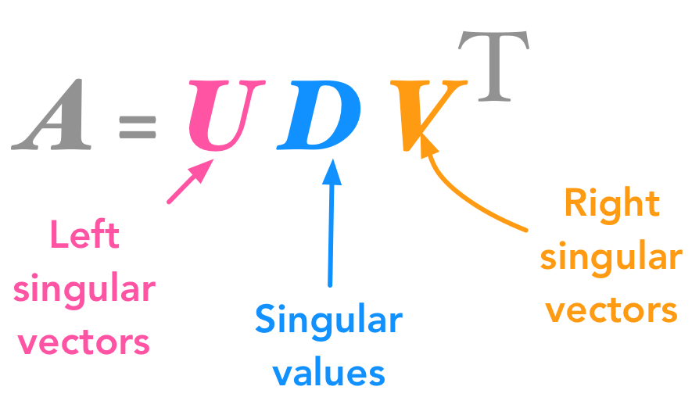
SINGULAR VALUE DECOMPOSITION
Singular Value Decomposition a method from linear algebra that has been generally used as a dimensionality reduction technique in machine learning
SVD is used as a collaborative filtering technique. It uses a matrix structure where each row represents a user, and each column represents an item. The elements of this matrix are the ratings that are given to items by users.

Slide 39
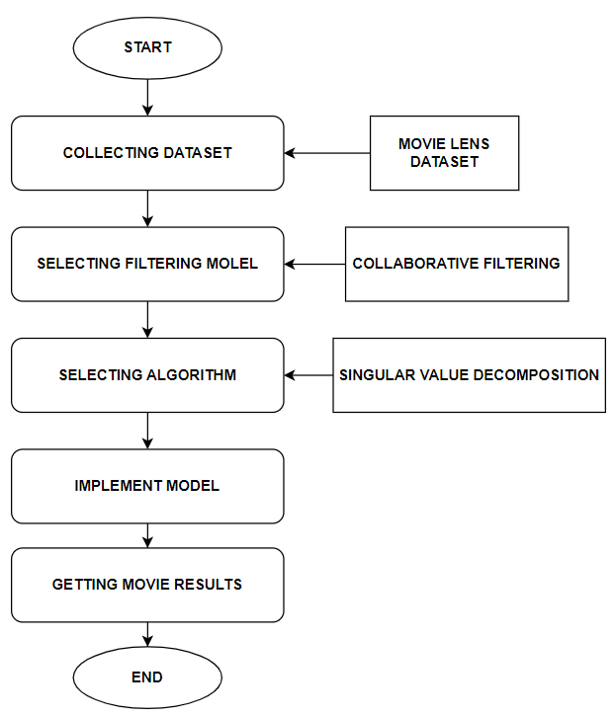
General Task Involved

Slide 40
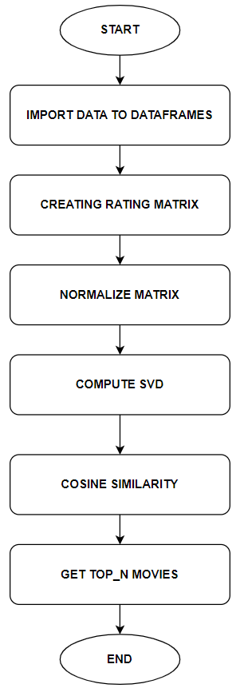
Machine Learning Model Process

Slide 41
RESULTS

Slide 42
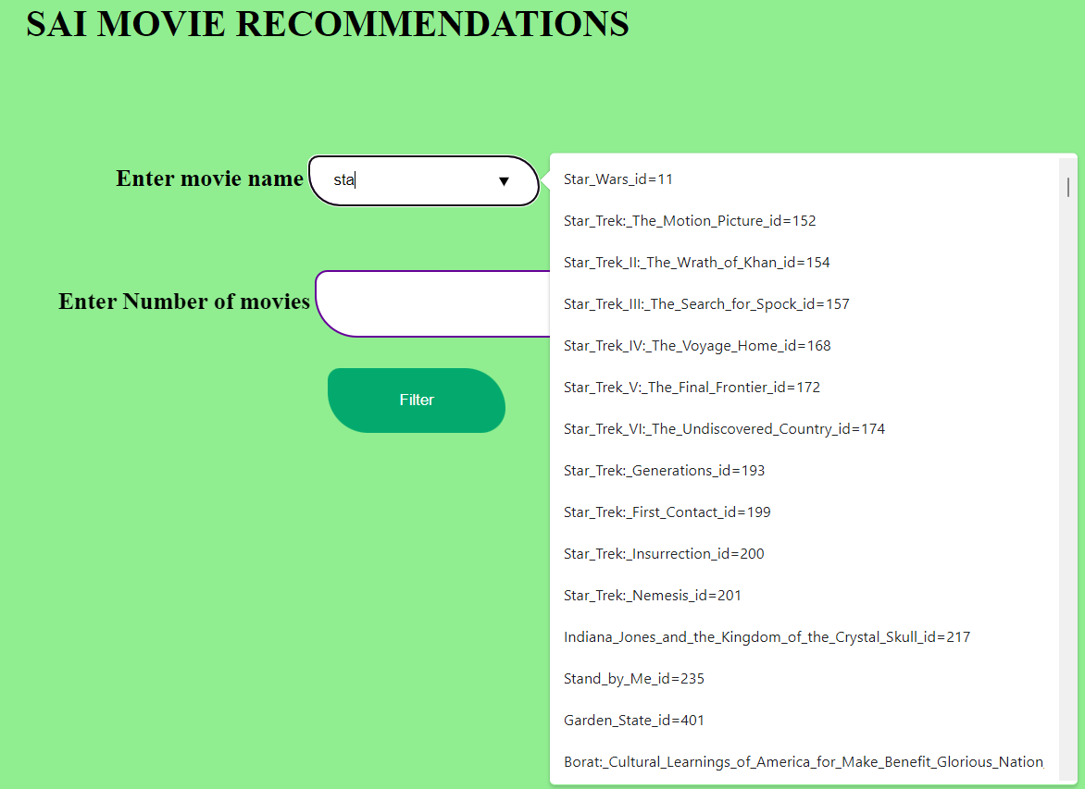
Selecting Movie Name Using Data List

Slide 43
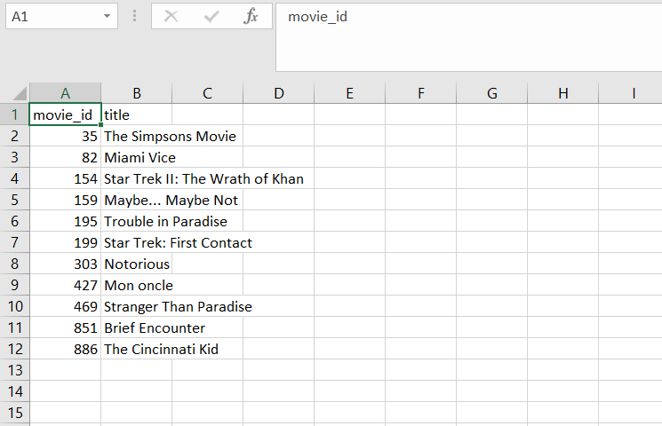
Saving Output movie data in csv file

Slide 44
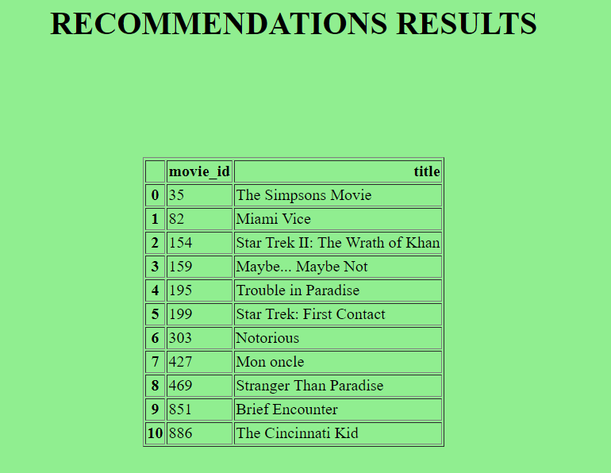
Displaying Movie Data in Webpage

Slide 45
CONCLUSION

Slide 46
Users can use this website to get the movies names which are similar to their favourite movie.
It is easy to use interface just need to select movie name and enter movie count and click filter button

Slide 47
FUTURE SCOPE

Slide 48
This model can be integrated to any movie streaming platforms like Hotstar , prime video to recommend films based on user watch history.
With increase in movie data and ratings the model will get more accurate.

Slide 49
REFERENCES

Slide 50
[1] Furtado, F., and A. Singh. "Movie recommendation system using machine learning." International journal of research in industrial engineering 9.1 (2020): 84-98.
[2] Smitha, N., et al. "A Review on Movie Recommendation System Using Machine Learning." 2021 Third International Conference on Intelligent Communication Technologies and Virtual Mobile Networks (ICICV). IEEE, 2021.
[3] Surendran, Akansh, Aditya Kumar Yadav, and Aditya Kumar. "Movie recommendation system using machine learning algorithms." Int Res J Eng Technol (2020).
[4] Purnomo, Johan Eko, and Sukmawati Nur Endah. "Rating prediction on movie recommendation system: collaborative filtering algorithm (CFA) vs. dissymetrical percentage collaborative filtering algorithm (DSPCFA)." 2019 3rd International Conference on Informatics and Computational Sciences (ICICoS). IEEE, 2019.
[5] Cintia Ganesha Putri, Debby, Jenq-Shiou Leu, and Pavel Seda. "Design of an unsupervised machine learning-based movie recommender system." Symmetry 12.2 (2020): 185.
[6] Kashyap, Ashrita, et al. "A movie recommender system: MOVREC using machine learning techniques." International Journal of Engineering Science and Computing 10.6 (2020).

Slide 51
PROJECT TIMELINE

Slide 52
PROJECT ACCEPTED
MOVIE RECOMMENDATION SYSTEM USING MACHINE LEARING
PHASE 3
1. INTEGRATION OF FRONTEND AND MACHINE LEARING MODEL USING FLASK FRAMEWORK
2. DOCUMENTATION
3.WORKING ON ACCURACY
FINAL REVIEW
1.FULL WORKING MOVIE RECOMMENDATION WEBSITE
2.PROJECT REPORT
PHASE 1
REVIEW 1
PHASE 2
REVIEW 2
1.OBJECTIVES
2.MOTIVATION
3.PROBLEM SURVEY
4.TECHNOLOGIES
5.ARCHITECTURE DIAGRAM
6.HYPOTHESIS
1.LITERATURE SURVEY
2.PROJECT ARCHITECTURE
3.DATASETS COLLECTION
4.MACHINE LEARNING ALGORITHM
1.WEBSITE FRONTEND
2.DATA PREPROCRESSING
3.DEVELOPING MACHINE LEARNING MODEL
4.LEARN FLASK FRAMEWORK
5.UML DIAGRAMS DESIGN
1.WORKING FRONTEND OF WEBPAGE
2. WORKING MACHINE LEARNING MODEL
3. UML DIAGRAMS
START
11 AUGUST 2022
22 OCTOBER 2022
23 NOVEMBER 2022
17 DECEMBER 2022

Slide 53
Thank You

